Slide 1

Safe Meds - AI Prescription Verification System
Team members:
M.Bhanu Prakash (team lead)
K.Vamshi
N.Hanumanth

Slide 2
Problem Statement
Manual prescription reading causes errors and misuse
Difficult for patients to understand medicines
No quick check for drug interactions and dosage safety
Risk for kids, seniors ,chronic patients

Slide 3
Proposed Solution
AI powered OCR system to extract text from prescriptions
Store prescriptions digitally (DB and PDF)
Age specific dosage recommendations
Alternative safe medicines suggestions
Simple UI for patients/doctors

Slide 4
System Architecture
Upload prescription (frontend)
OCR processing (FastAPI and tesseract)
NLP processing (HuggingFace / IBM Watson)
Database storage (SQLite —Scalable to PostgreSQL)
Output
Extracted medicines
PDF report
Alerts and suggestions

Slide 5
Technology Stack
Backend: FastAP, SQLAlchemy
Database: SQlite
OCR: tesseract + PIL
PDF Reports: FPDF
NLP: HuggingFace models
Drug Info API: IBM Watson/ Drugbank
Frontend: Streamlit

Slide 6
Features Implemented
Upload prescriptions & extract text
Store data in database
Search prescriptions by patient/medicine
Download PDF reports
(Planned: Drug interaction, dosage rules, alternatives)

Slide 7
Impact
Patients — better understanding of prescription
Doctors — avoid drug interactions
Paharmacists — faster validation
Society — reduce medical errors

Slide 8

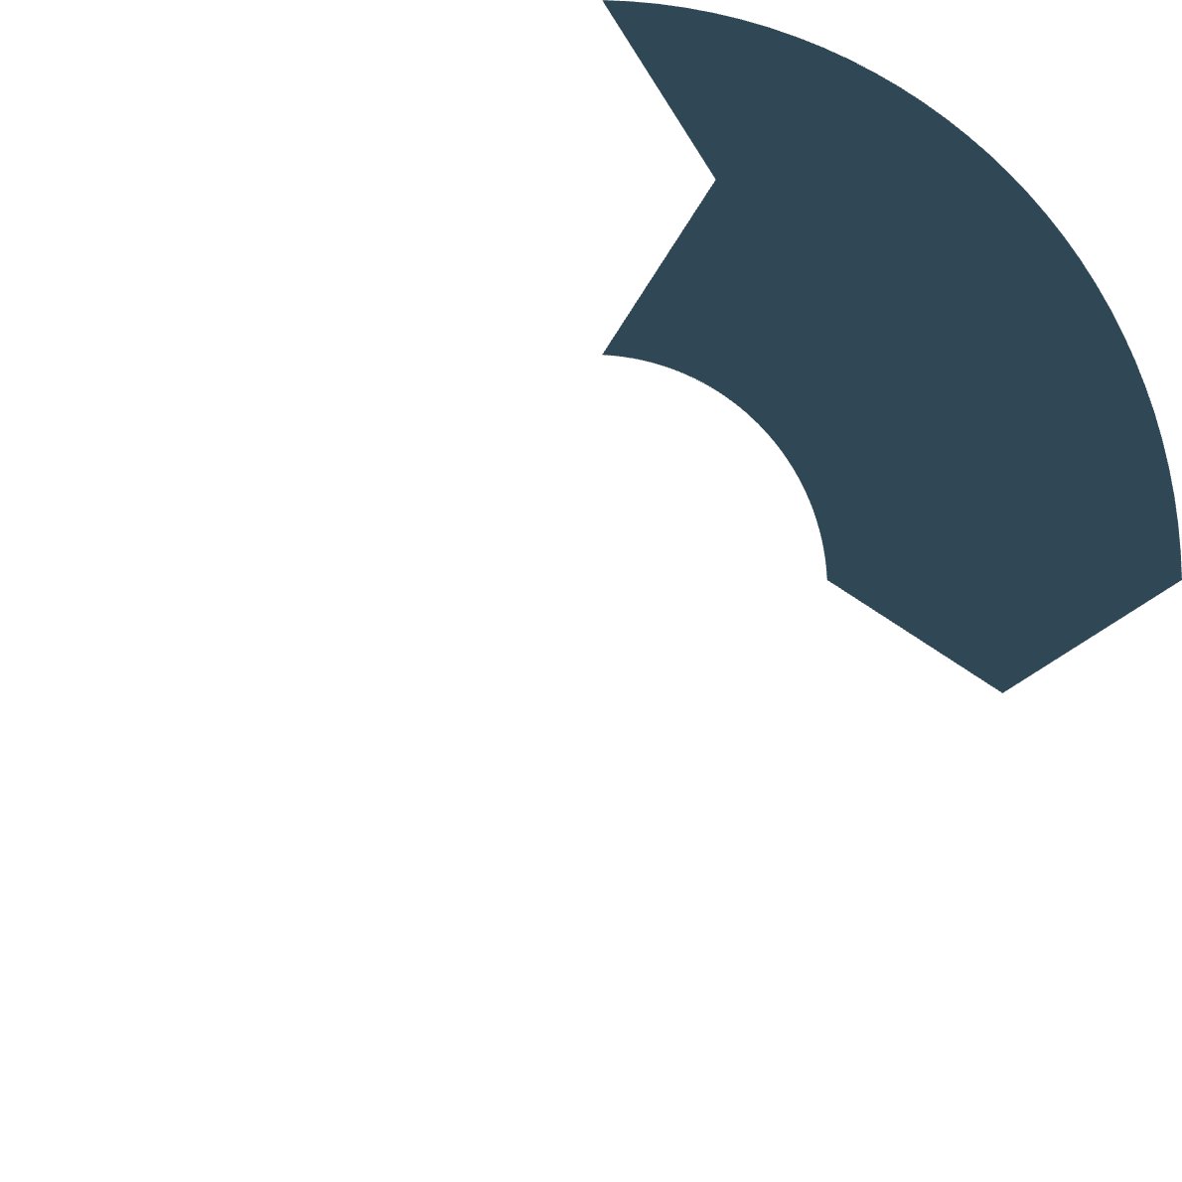






Future Scope
Mobile App Integration
Multilingual Support
Integration with hospital database
Prescription translation
Enhanced ML Models
EHR Integration
Multi-language OCR
AI dosage prediction
Full drug interaction detection(drug bank API)

Slide 9
Thank You

